Slide 1


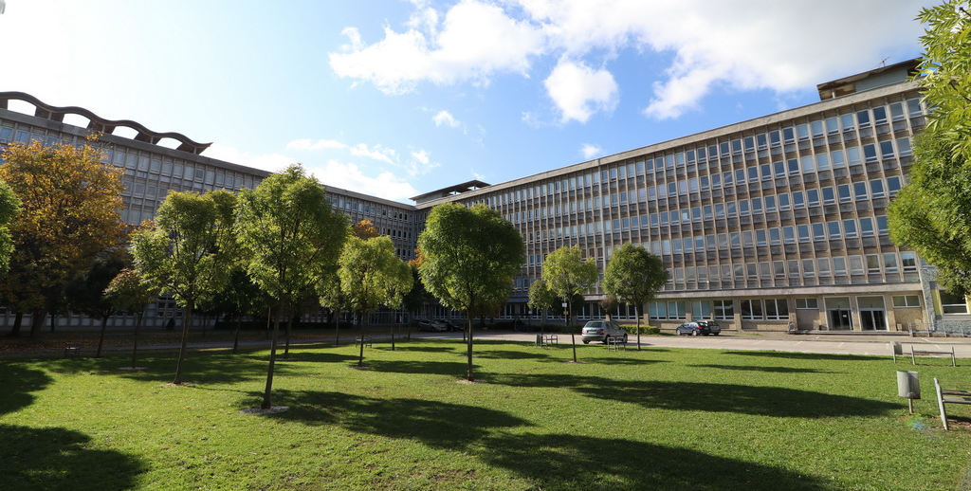

Title of the Paper
A. Author, B. Author, C. Author
NEW TRENDS IN AVIATION DEVELOPMENT NTAD 2024
Introduction
Authors are kindly requested to use this template format for the New Trends in Aviation Development conference. The heading of the poster should utilize the Rockwell font, bold, size 90. The names of the authors should be in the Rockwell font, bold and italic, size 60. Headings of individual sections should be in the Palatino font, size 60. The general text should use the Palatino font, size 36. The text in the Acknowledgement section should use the Palatino font, italicized, size 32. Figures and tables should use the Palatino font, italicized, size 32.
Results & Discussion
Use a zero before decimal points: “0.25”, not “.25”. Use “cm3”, not “cc”. The equations are an exception to the prescribed specifications of this template. You will need to determine whether or not your equation should be typed using either the Times New Roman or the Symbol font (please no other font). To create multileveled equations, it may be necessary to treat the equation as a graphic and insert it into the text after your paper is styled. Number equations consecutively. To make your equations more compact, you may use the solidus ( / ), the exp function, or appropriate exponents. Italicize Roman symbols for quantities and variables, but not Greek symbols. Use a long dash rather than a hyphen for a minus sign. Punctuate equations with commas or periods when they are part of a sentence.
Some common mistakes:
The word “data” is plural, not singular.
The subscript for the permeability of vacuum µ₀, and other common scientific constants, is zero with subscript formatting, not a lowercase letter “o”.
Do not use the word “essentially” to mean “approximately” or “effectively”.
Be aware of the different meanings of the homophone “affect” and “effect”, “complement” and “compliment”, “discreet” and “discrete”, “principal” and “principle”.
The prefix “non” is not a word; it should be joined to the word it modifies, usually without a hyphen.
• The word “data” is plural, not singular.
• The subscript for the permeability of vacuum 0, and other common scientific constants, is zero with subscript formatting, not a lowercase letter “o”.
• In American English, commas, semicolons, periods, question and exclamation marks are located within quotation marks only when a complete thought or name is cited, such as a title or full quotation.
Conclusion
This template provides authors with most of the formatting specifications needed for preparing electronic versions of their papers. All standard paper components have been specified for three reasons: (1) ease of use when formatting individual. papers, (2) automatic compliance to electronic requirements that facilitate the concurrent or later production of electronic products, and (3) conformity of style throughout a conference proceedings.
Methods
Please feel free to adjust the sizes of individual windows and the overall layout of the template according to your needs. Figure captions should be place below the figures. Table captions should be placed above the tables. The template is used to format your paper and style the text. Define abbreviations and acronyms the first time they are used in the text, even after they have been defined in the abstract. Do not use abbreviations in the title or heads unless they are unavoidable.
Figure 2 Technical university of Košice
Table 1 Table caption should be above the table
Column 1 | Column 2 | Column 3 | Column 4 | Column 5 | Column 6
Row 1 | Result 12 | Result 13 | Result 14 | Result 15 | Result 16
Row 2 | Result 22 | Result 23 | Result 24 | Result 25 | Result 26
Row 3 | Result 32 | Result 33 | Result 34 | Result 35 | Result 36
Row 4 | Result 42 | Result 43 | Result 44 | Result 45 | Result 46
Acknowledgement
This template provides authors with most of the formatting specifications needed for preparing electronic versions of their papers. All standard paper components have been specified for
Figure 1 The venue of the conference – Grand Hotel Starý Smokovec

