Slide 1
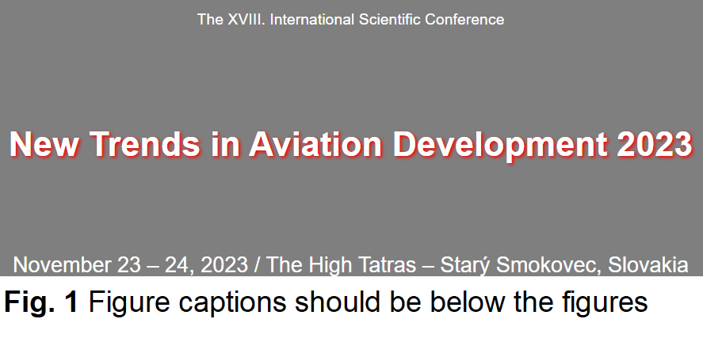
November 23 - 24, 2023, Grand Hotel Starý Smokovec, High Tatras, Slovakia
NTAD 2023 Conference Office
elfa, s.r.o.
Park Komenského 7,
040 01 Košice
Slovakia
tel.: + 421-55-625 3839
fax: + 421-55-726 5195
e-mail: elfa@elfa.sk
Title of ePoster
F. Author1, S. Author2, T. Author3
Abstract — This document is a template and already defines the components of your paper [title, text, heads, etc.] in its style sheet. Unless there are six authors or more give all authors’ names; do not use “et al.”. *CRITICAL: Do Not Use Symbols, Special Characters, Footnotes, or Math in Paper Title or Abstract. *Note: Sub-titles are not captured in Xplore and should not be used.
I. INTRODUCTION
This template provides authors with most of the formatting specifications needed for preparing electronic versions of their papers. All standard paper components have been specified for three reasons: (1) ease of use when formatting individual papers, (2) automatic compliance to electronic requirements that facilitate the concurrent or later production of electronic products, and (3) conformity of style throughout a conference proceedings. Margins, column widths, line spacing, and type styles are built-in; examples of the type styles are provided throughout this document and are identified in italic type, within parentheses, following the example. Some components, such as multi-leveled equations, graphics, and tables are not prescribed, although the various table text styles are provided. The formatter will need to create these components, incorporating the applicable criteria that follow.
II. MAIN TEXT
The template is used to format your paper and style the text. All margins, column widths, line spaces, and text fonts are prescribed; please do not alter them. Define abbreviations and acronyms the first time they are used in the text, even after they have been defined in the abstract. Abbreviations such as IEEE, SI, MKS, CGS, sc, dc, and rms do not have to be defined. Do not use abbreviations in the title or heads unless they are unavoidable. Use either SI (MKS) or CGS as primary units. (SI units are encouraged.) English units may be used as secondary units (in parentheses). An exception would be the use of English units as identifiers in trade, such as “3.5-inch disk drive”. Avoid combining SI and CGS units, such as current in amperes and magnetic field in oersteds. This often leads to confusion because equations do not balance dimensionally. If you must use mixed units, clearly state the units for each quantity that you use in an equation. Use a zero before decimal points: “0.25”, not “.25”. Use “cm3”, not “cc”. The equations are an exception to the prescribed specifications of this template. You will need to determine whether or not your equation should be typed using either the Times New Roman or the Symbol font (please no other font). To create multileveled equations, it may be necessary to treat the equation as a graphic and insert it into the text after your paper is styled. Number equations consecutively. To make your equations more compact, you may use the solidus ( / ), the exp function, or appropriate exponents. Italicize Roman symbols for quantities and variables, but not Greek symbols. Use a long dash rather than a hyphen for a minus sign. Punctuate equations with commas or periods when they are part of a sentence.
Some common mistakes:
The word “data” is plural, not singular.
The subscript for the permeability of vacuum µ₀, and other common scientific constants, is zero with subscript formatting, not a lowercase letter “o”.
Do not use the word “essentially” to mean “approximately” or “effectively”.
Be aware of the different meanings of the homophones “affect” and “effect”, “complement” and “compliment”, “discreet” and “discrete”, “principal” and “principle”.
The prefix “non” is not a word; it should be joined to the word it modifies, usually without a hyphen.
The abbreviation “i.e.” means “that is”, and the abbreviation “e.g.” means “for example”.
A graph within a graph is an “inset”, not an “insert”. The word alternatively is preferred to the word “alternately” (unless you really mean something that alternates).
Use words rather than symbols or abbreviations when writing Figure axis labels to avoid confusing the reader. As an example, write the quantity “Magnetization”, or “Magnetization, M”, not just “M”. If including units in the label, present them within parentheses. Do not label axes only with units. In the example, write “Magnetization (A/m)” or “Magnetization {A[m(1)]}”, not just “A/m”. Do not label axes with a ratio of quantities and units. For example, write “Temperature (K)”, not “Temperature/K”.
III. CONCLUSION
IEEE conference templates contain guidance text for composing and formatting conference papers. Please ensure that all template text is removed from your conference paper prior to submission to the conference. Failure to remove template text from your paper may result in your paper not being published.
ACKNOWLEDGMENT
The preferred spelling of the word “acknowledgment” in America is without an “e” after the “g”. Avoid the stilted expression “one of us (R. B. G.) thanks ...”. Instead, try “R. B. G. thanks...”. This paper was supported/sponsored by...

